Slide 1
Online Event Scheduler
Under the guidance of:
Mentor: Prof. Jinjun Xiong TA: Amir Nassereldine By:
Lakshaye Vaikunth Ganesh Kumar
Arjun Ragavendaar Sripathy
Sri Harshitha Palla
Divya Sharma
Venkatesh Mandapati

Slide 2
Progress in the previous week
Created tasks for all components and assigned them to respective owners
Segregated technical design into following modules:
UI/Backend-Create Main Pages
UI/Backend-Calendar View
UI/Backend-Confirmation page and Link sharing
UI/Backend-Registration and Login Page
UI/Backend-Meeting modification
Worked on refinement of wireframes
(https://github.com/xlab-classes/cse611-spring2023-OnlineEventScheduler/blob/main/Artifacts/Initial_Wireframe_V1.pdf)

Slide 3
Goals for next week
Create project skeleton
Basic functionality on frontend, backend, and database
Deploy all components on a cloud server (GCP) to test basic end-to-end flow.

Slide 4
Tasks planned for 3/3 - 8/3
UI - Create Homepage
UI - Create Group Poll/Meeting Selection Page
UI - Create Group Poll Form Page
UI - Create Meeting Form page
DB - Designing the database schema
Backend - Create structure for backend development
Backend - Create API to initiate poll
Backend - Create API to store details of poll participants
Backend - Modify retrieved database information to required response format
Backend - Create schemas for the DB

Slide 5
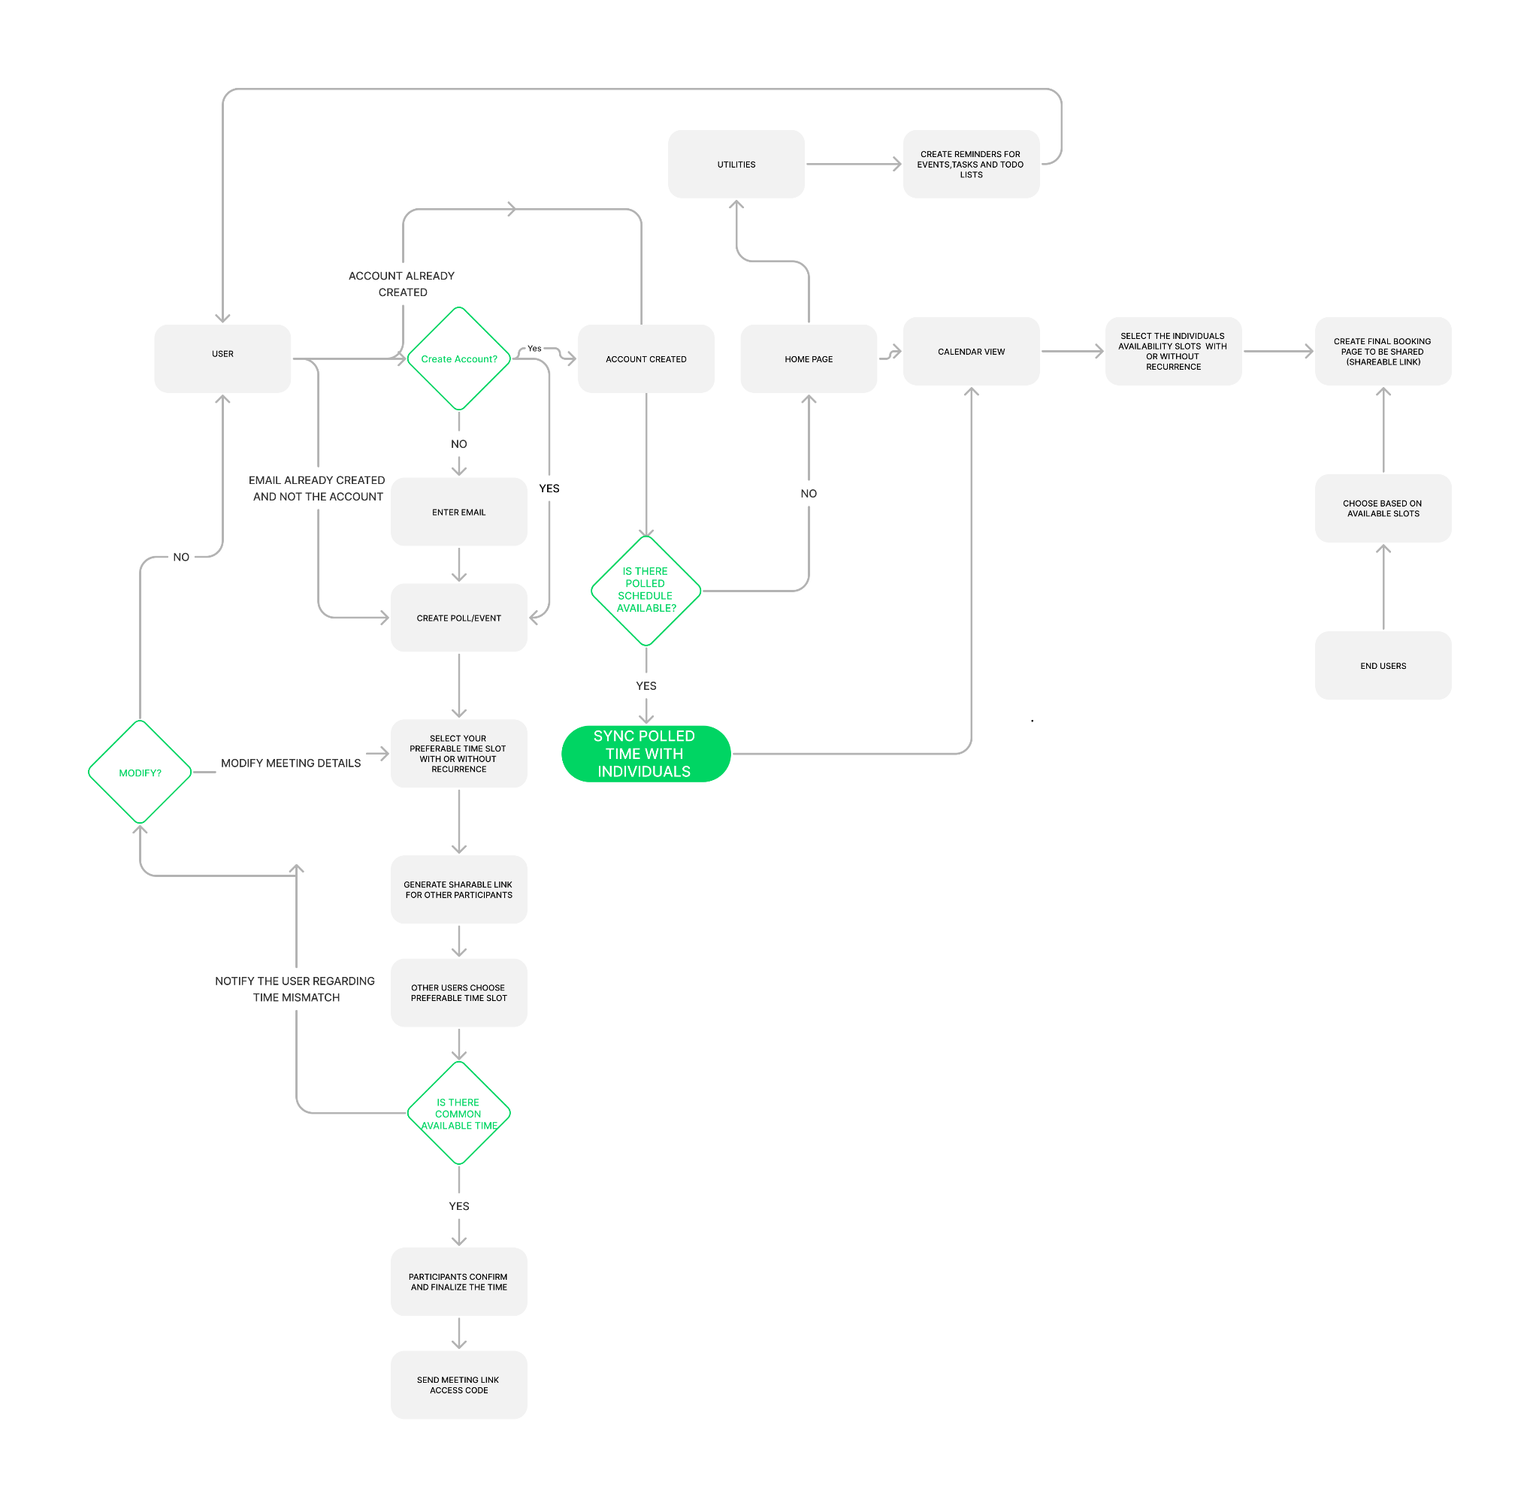
Functional Flow Diagram

Slide 6
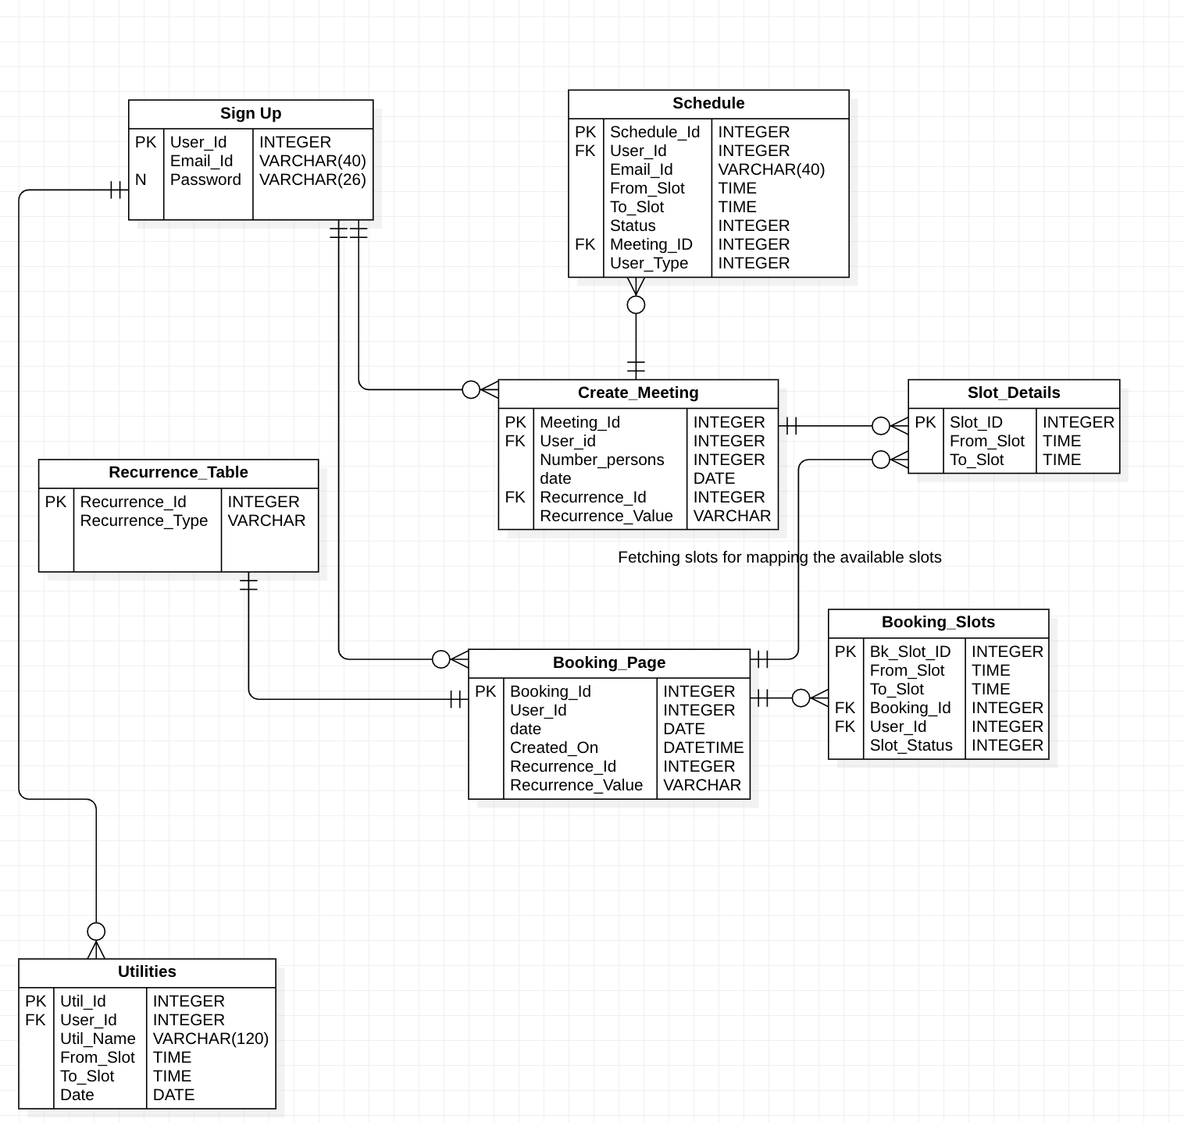
ER Diagram

Slide 7
References
https://www.figma.com/community/file/1163829368060240534
https://doodle.com/
https://learn.microsoft.com/en-us/outlook/rest/get-started
https://www.g2.com/categories/event-management-platforms
https://www.ijraset.com/research-paper/event-scheduler
Naman Jain1 , Shaik Abhishaik1 “Event Scheduler” International Journal for Research in Applied Science & Engineering Technology (IJRASET)
https://www.figma.com/file/6disvT7ST9wNWoBzgFfSQ2/Flow-Chart-Template-(Copy)?node-id=0%3A1&t=XR9uLt7zOxOfFNDN-0

Slide 8
THANK YOU

